Slide 1


Invent India TMT – Monthly Updates
July 2026

Slide 2
Agenda
01 | People's Corner: Welcome New Member, Birthdays, Work Anniversaries and Celebrating Recognitions
02 | 2026 Strategic Ambition: Targets Achieved and The Final Goal
03 | Progress Snapshot: Where We Stand Today
04 | Execution Blueprint: Strategic Approach and Key Initiatives to Achieve Our Target
05 | TMT Focus Areas- Where We Are Investing Efforts and Driving Market Impact
06 | Industry insights & Knowledge Sharing : Demo of Co-pilot Driven Dashboard

Slide 3

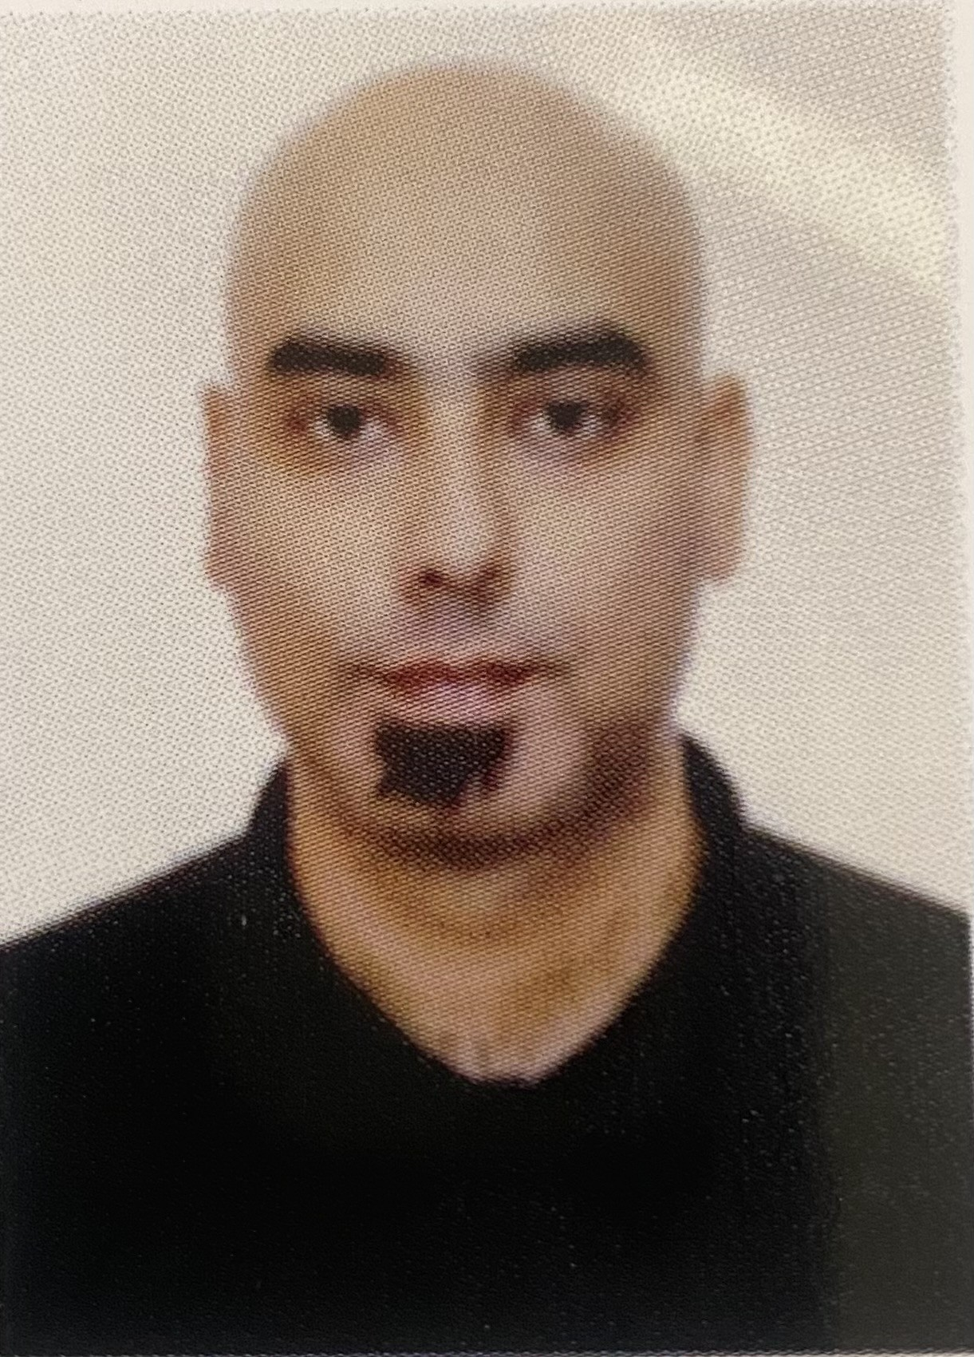


Welcome to Invent India Telco Team !!
Sachin Tewari
Sachin has done Bachelor of Engineering from SRMCEM College, GBTU University.
He is joining us with 8.6+ years of experience in Business & Telecom process consulting, digital transformation, management consulting and agile project management.
Worked primarily in the Telecommunication domain.
He has been previously been associated with firms involving IT and Service and worked with Telecom throughout for major Telco's in UK, Europe and LATAM geography
Joined us on 22nd June
Outside work, he enjoys exploring new places—both within the city and while travelling—as a way to discover different cultures, experiences, and perspectives. He also enjoy keeping up with technology and business transformation trends
Birthday
04th Aug
Location
Noida
TMT Monthly Update | July 2026

Slide 4

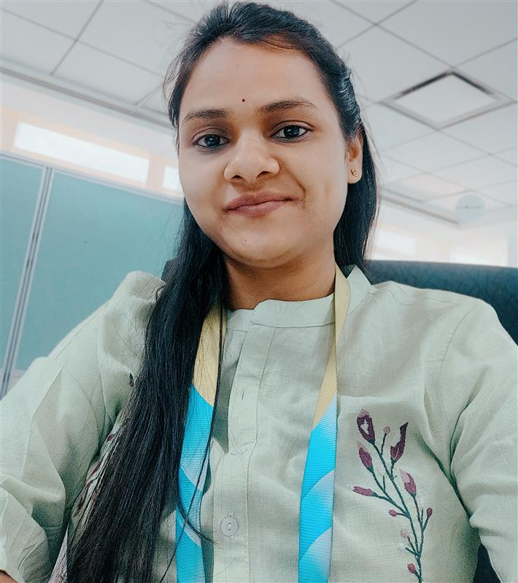
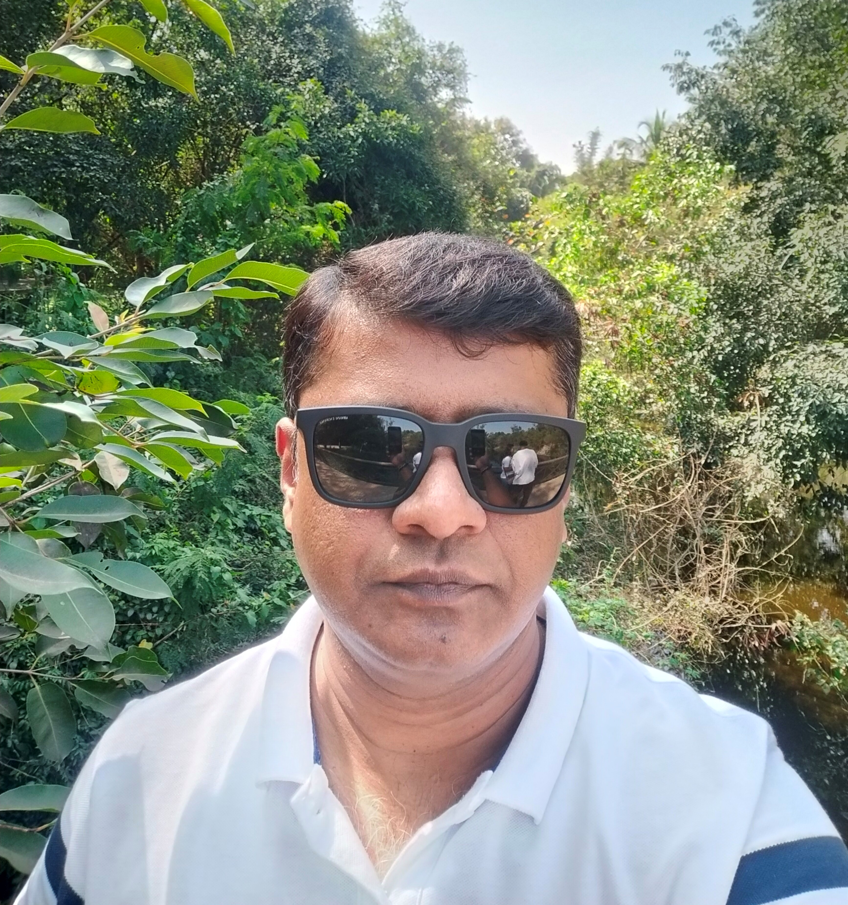

Birthday Wishes to our Team Members
Apurva More
9th Jul
Rajendra Singh
20th Jul

Slide 5

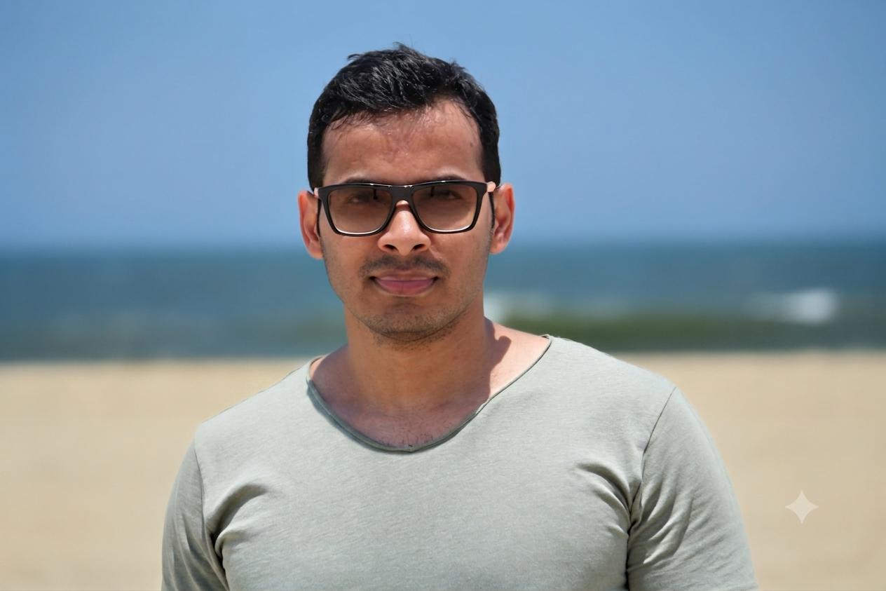
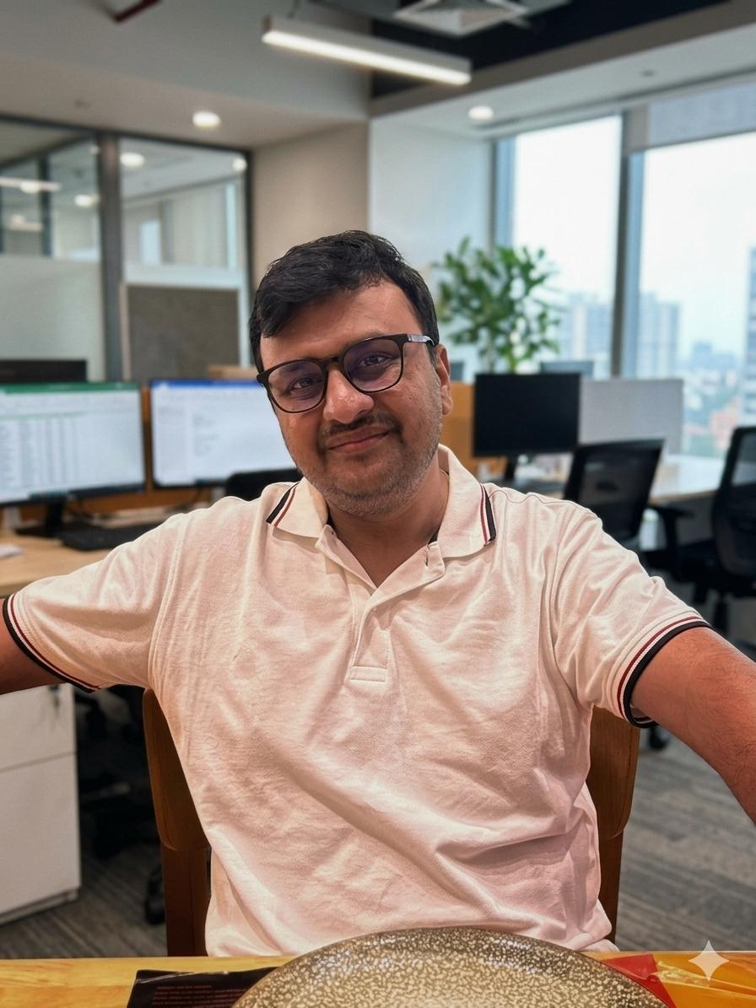
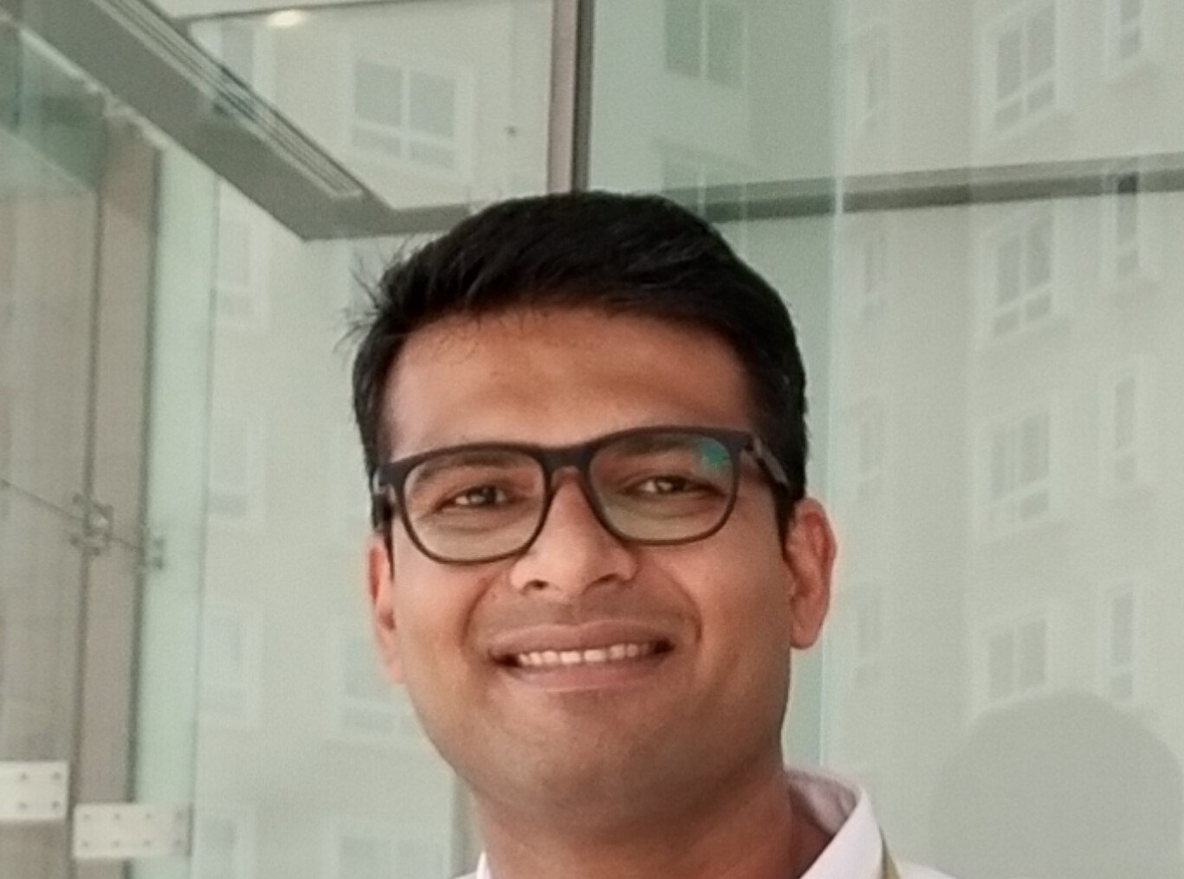


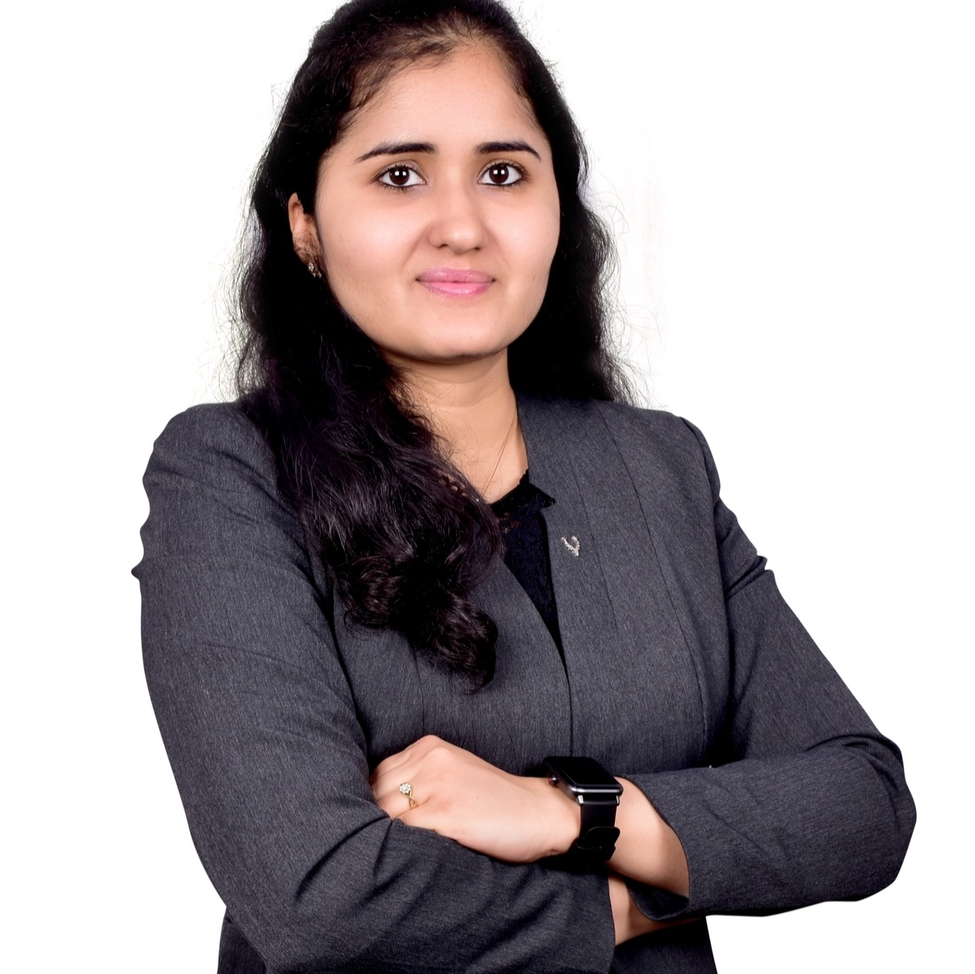
Work Anniversary of our Team Member
Praveen Kutty
Abhishek Chaudhari
Praveen Kutty
Atanu Basu
Shikha Singh
Kajal Dasani

Slide 6

Awards and Recognition
Srishti (Telia)
Received appreciation for her hard work, strong ownership, and confidence in driving discussions as an ITBA in a complex B2B transformation.
Also recognized for proactively learning Figma and creating order capture journey visualizations, demonstrating continuous learning and growth.
Shoutouts & Kudos
Prabhatha (Nuuday)
Appreciated by stakeholders for outstanding contributions to TDC Brands and the successful delivery of the Hansen Carveout program. Recognized for being a dependable team member, providing strategic guidance, driving collaboration, and consistently supporting the team during critical project milestones and decision-making.
Amit, Himanshu, Parth (Vodafone Autonomous Networks Win)
Secured a $700K Vodafone Group Autonomous Networks engagement. Invent India share up to $100K in the initial assessment phase. Supporting Vodafone’s journey to AI-driven Level 4 Autonomous Networks.
Vikas (CMA CGA)
Strengthened the CMA CGM partnership through leadership engagement in Marseille. Supported the growth of the Capgemini Invent India-led R&D Hub across AI, Digital Twins, and Robotics. Showcased Digital Twin solutions at VivaTech 2026, highlighting our global innovation impact.
Your excellence lit up — let’s keep the fire burning!

Slide 7
Agenda
01 | People's Corner: Welcome New Member, Birthdays, Work Anniversaries and Celebrating Recognitions
02 | 2026 Strategic Ambition: Targets Achieved and The Final Goal
03 | Progress Snapshot: Where We Stand Today
04 | Execution Blueprint: Strategic Approach and Key Initiatives to Achieve Our Target
05 | TMT Focus Areas- Where We Are Investing Efforts and Driving Market Impact
06 | Industry insights & Knowledge Sharing : Demo of Co-pilot Driven Dashboard

Slide 8


2026 Growth Objectives: Bookings & Revenue
BOOKINGS
REVENUE
3 ME
6 ME
9 ME
12 ME
0.5 ME
1 ME
1.5 ME
2 ME
2.5 ME
2024
3.6
3.3
TMT: 6.9 ME
2024
TMT: 1.58 ME
2025
4.3
3.9
TMT: 8.2 ME (+18%)
2025
TMT: 2.1 ME (+34%)
2026*
4.4
3.9
TMT: 8.3 ME
2026
TMT: 2.4 ME
Mid-Year Assessment : Distance to Target!
Bookings: 4420 KE Revenue: 1291 KE
Telco
Media & Tech.

Slide 9
Agenda
01 | People's Corner: Welcome New Member, Birthdays, Work Anniversaries and Celebrating Recognitions
02 | 2026 Strategic Ambition: Targets Achieved and The Final Goal
03 | Progress Snapshot: Where We Stand Today
04 | Execution Blueprint: Strategic Approach and Key Initiatives to Achieve Our Target
05 | TMT Focus Areas- Where We Are Investing Efforts and Driving Market Impact
06 | Industry insights & Knowledge Sharing : Demo of Co-pilot Driven Dashboard

Slide 10
June 2026 Performance Dashboard
(Booking & Pipeline)
1179 KE INTER (36%) | 2084 KE INTRA (64%)
47%
3880 KE Booking
YTD Target 4150 KE (end of Jun) – 50%
1877 KE
2003 KE
3263 KE in Pipeline (Wtd.)
5212 KE in Pipeline (TCV)
Booking performance is tracked at 270 KE below the target

Slide 11
Segment Mix & Pipeline Coverage Trend | Jan–Jun 2026
Booking Achieved – MoM (KE)
Pipeline-to-Sold Coverage (x)
Inter vs. Intra Segment Mix (%)
Ideal: 692 KE
INTRA
INTER
June end coverage :
TCV Pipeline (5212 KE) / TCV Sold (3880 KE)
Progress Towards Booking Target: Jun end Booking is 47%
YoY % de-growth clocked at -26%
Pipeline Coverage:
Opportunities in stages 6 and 7 comprise of Total 3803 KE (73% of TCV)
Segment Priority: INTER% increased by 4% vs May. Revenue attainment remains at 46%. Funnel composition is skewed toward INTRA opt’s. Focus is to increase INTER-to-Sold conversion
Segment Shift: INTER eased ↓7% (60%→53%); INTRA rose to 47%, driven by volume pressure in key INTER accounts.
TMT Monthly Update | July 2026
Company Confidential © Capgemini 2026. All rights reserved.

Slide 12


















June 2026 Performance Dashboard
(Top Markets & Accounts - Booking)
185
201
Germany
NCE = 789 KE
171
123
NA = 1638 KE
225
SCE = 845 KE
India = 229 KE
223
245
108
182
292
49
Egypt
164
132
149
140
140
ME = 15 KE
ANZ = 318 KE
120
331
15

Slide 13





June 2026 Performance Dashboard
(Top Markets & Accounts - Pipeline)
179
Germany
NCE = 1100 KE
141
UK
NA = 820 KE
197
SCE = 320 KE
India = 276 KE
181
133
172
124
118
ME = 387 KE
ANZ = 449 KE
Key Takeaway
Focus on conversion of Pipeline to Sold across Accounts with higher Pipeline
367
338
99
Opportunities in Stages 6 and 7 Comprises of Total 3803 KE (73% of TCV)

Slide 14
Revenue | ARVE | Inter CM
June 2026
46%
73%
53%
1109 KE Revenue
(Target (1.2 ME)
- 50%)
ARVE%
(Target 70%)
CM% Inter
(Target 46%)
REVENUE
as of Jun
ARVE%
as of Jun
CM% (INTER)
as of Jun
ARVE: Activity Rate (Vacation Excluded)
CM: Contribution Margin

Slide 15
Strategic Growth Approach
Target Revenue : 2400K
Revenue Confirmed: 1109 KE Revenue %: 46% Current Gap: 1291K
CURRENT: Resources: 47 | Bench: 10 | Inter Projects: 52% | New Joiners Confirmed: 3 I New Hires Planned: 4
Recommended Plan for Gap Reduction
Accelerate closure efforts for Inter Pipeline opportunities (Stages 6 & 7)
Callout to Account owners managing INTER accounts, to explore new roles within existing engagements
Leverage bench resources to support RFP activities by aligning them to relevant bid codes (Source Bid Codes for RFP’s)
Encourage resources to take on cross-domain opportunities where skills and experience align
3 new laterals to join in Aug’26. Plan for rapid deployment of three new lateral hires across active and pipeline opportunities
Account Owners should prioritize immediate deployment of bench resources to projects that enable on-the-job learning and upskill through practical project exposure
Resources build AI capabilities through self-paced learning, assigned trainings, and participate in “AI for Us, From Us” forums to become AI ready for upcoming opportunities

Slide 16
Agenda
01 | People's Corner: Welcome New Member, Birthdays, Work Anniversaries and Celebrating Recognitions
02 | 2026 Strategic Ambition: Targets Achieved and The Final Goal
03 | Progress Snapshot: Where We Stand Today
04 | Execution Blueprint: Strategic Approach and Key Initiatives to Achieve Our Target
05 | TMT Focus Areas- Where We Are Investing Efforts and Driving Market Impact
06 | Industry insights & Knowledge Sharing : Demo of Co-pilot Driven Dashboard
Company Confidential © Capgemini 2026. All rights reserved.

Slide 17
ENABLE:
Solution Advisory Group:
Shaping solution-led conversations
FoP Advisory Group:
Invent Capability-led enablement
Solution Owner | Capability names | FY26 target (KE)
Abhishek | GenAI advisory | 100
Shikha | Solution Design advisory - BSS | 200
Nilesh | COTS advisory | 250
Kaustubh | BA advisory | 350
Mayank | PM advisory | 300
Sameer | Solution Arch Advisory | 100
Prakash | SFDC advisory | 100
Dipti | Process advisory | 250
Pravin | EA advisory | 350
Saurabh | SNOW advisory | 150
Chandamita | Service Design Advisory | 200
Parth | AN advisory | 100
Shripriya | Solution Design advisory - OSS | 200
Total |  | 2650
FoP owner | FoP names | FY26 Target (KE) | Achieved (KE)
Amit | ET-BT (*interim coverage) | 1100 | 736
Rajendra | EDA - DFRC | 600 | 421
Prabhatha | II | 225 | 316
Shikha | EDA - DSF | 500 | 347
Sameer | IPP (exc. Dell account) | 400 | 252
Shripriya | KMCoE | 200 | 178
Dipti | ET -W&O | 300 | 52
Chandamita | ET - CE + ET - PA | 300 | 33
Gazal | frog | 350 | 17
Nikita | Sustainability | 100 | 0
Total |  | 4075 | 2352
**Achieved Numbers to be Recalculated
Overall FoP Advisory Targets achieved – 58%

Slide 18
























GROW:
Unlocking opportunity pipelines
FY26 Target (KE)
Achieved (KE)
Praveen | 780 | 610
Atanu | 675 | 459
Subrata | 1175 | 346
Mayank | 215 | 292
Rajendra | 205 | 393
Parth | 385 | 198
Saurabh | 375 | -
Kaustubh | 400 | 185
Prabhatha | 315 | 171
Kunal | 155 | 165
Pragya | 310 | 140
Amit | 445 | 109
Prakash | 495 | 104
(Denmark & Italy)

Slide 19

















GROW:
Unlocking opportunity pipelines
FY26 Target (KE)
Achieved (KE)
Abhishek | 540 | 131
Dipti | 270 | 107
Rajkamal | 230 | 120
Himanshu | 135 | 54
Amruta | 300 | 123
Vikas | 185 | 41
Nilesh | 315 | 49
Nikita | 225 | 27
Gazal | 170 | 15
Total | 8300 | 3839
(UK)
Opportunity Pipelines Targets achieved – 46%

Slide 20
Agenda
01 | People's Corner: Welcome New Member, Birthdays, Work Anniversaries and Celebrating Recognitions
02 | 2026 Strategic Ambition: Targets Achieved and The Final Goal
03 | Progress Snapshot: Where We Stand Today
04 | Execution Blueprint: Strategic Approach and Key Initiatives to Achieve Our Target
05 | TMT Focus Areas- Where We Are Investing Efforts and Driving Market Impact
06 | Industry insights & Knowledge Sharing : Demo of Co-pilot Driven Dashboard
TMT Monthly Update | July 2026

Slide 21







RFPs & Proactive Pitches
CWS
Nokia
T-Mobile
Vodafone
VMO2
Design a comprehensive, enterprise-wide 3-year Digitalization and Artificial Intelligence Strategy to produce a pragmatic, execution-ready, and actionable roadmap
Enterprise stack agentic AI transformation and modernization deploying agentic control pane
Discussions with account team to formulate a AN Assessment and Advisory strategy to be proposed to T-mobile Chief Network Officer
The engagement includes maturity assessments, target-state architecture, and a phased transformation roadmap based on TM Forum ANL and IAADE frameworks to simplify network and reduce costs
Submitted a four-week proposal to O2 Business to establish AI Governance foundations, including policy recommendations, risk classification, and guardrails for existing PoCs.
Tuatahi
Fastweb + Vodafone
Telia
Leading OSS and product‑rationalization transformation using ServiceNow, ArcGIS, Salesforce, MACD automation and PLM with Invent, DCX and Sogeti
Fastweb and Vodafone will consolidate vendors and automate operations to cut overlap, reduce costs, improve efficiency, and scale through centralization and harmonization
Proactive Agentic workflow for L2OAccelerating Agentic AI‑powered finance modernization across FP&A, forecasting, fraud management, and planning with tailored AI use‑case development
TMT Monthly Update | July 2026

Slide 22







Ongoing Assignments
Lead BA
Business Analyst
Solution Arch.
Business Analyst
Epic Owner
BA/SD & TPM
To support a billing-transformation initiative through Requirements Framework, reference data model and Target Operating model, including technology gap assessment for Kenan and Oracle BRM
(Telefonica Germany)
Focused on translating business requirements into clear, actionable inputs for developers, supporting data-driven solutions using Data Lake technologies in the OSS
Bridges the gap between business, architecture, and development to ensure smooth, efficient, and accurate delivery of technical solutions
Responsible for business analysis and solution design within a large‑scale B2B transformation program
Leading strategic capability definition and delivery through integrated business analysis and solution design
Comcast’s XTO Experience Transformation program, supporting a multi‑year initiative to overhaul customer service and overall customer experience
Process Designer
Program Mgmt.
BA/PO
Business Analyst
SD and PgM
(Telefonica Spain)
Leading end‑to‑end capability design and delivery to enable a more integrated, scalable and efficient operating model
Program Management and client engagement for CMA CGM’s R&D Hub (GCC engagement) focusing on AI, Robotics, Digital Twins and R&D Tools
Service Manager Migration, implementing WOA for Feasibility Check and New Service Provisioning (incl. MACD) in Colombia and scaling WOA and integrations across LATAM
We are working with the IndiGo AI Innovation Lab to build and scale AI-driven products for the airline
Responsible for creating Nuuday’s own independent Provisioning and Assurance stack, to move away from TDC IT stack
TMT Monthly Update | July 2026

Slide 23
Agenda
01 | People's Corner: Welcome New Member, Birthdays, Work Anniversaries and Celebrating Recognitions
02 | 2026 Strategic Ambition: Targets Achieved and The Final Goal
03 | Progress Snapshot: Where We Stand Today
04 | Execution Blueprint: Strategic Approach and Key Initiatives to Achieve Our Target
05 | TMT Focus Areas- Where We Are Investing Efforts and Driving Market Impact
06 | Industry insights & Knowledge Sharing : Demo of Co-pilot Driven Dashboard
TMT Monthly Update | July 2026

Slide 24
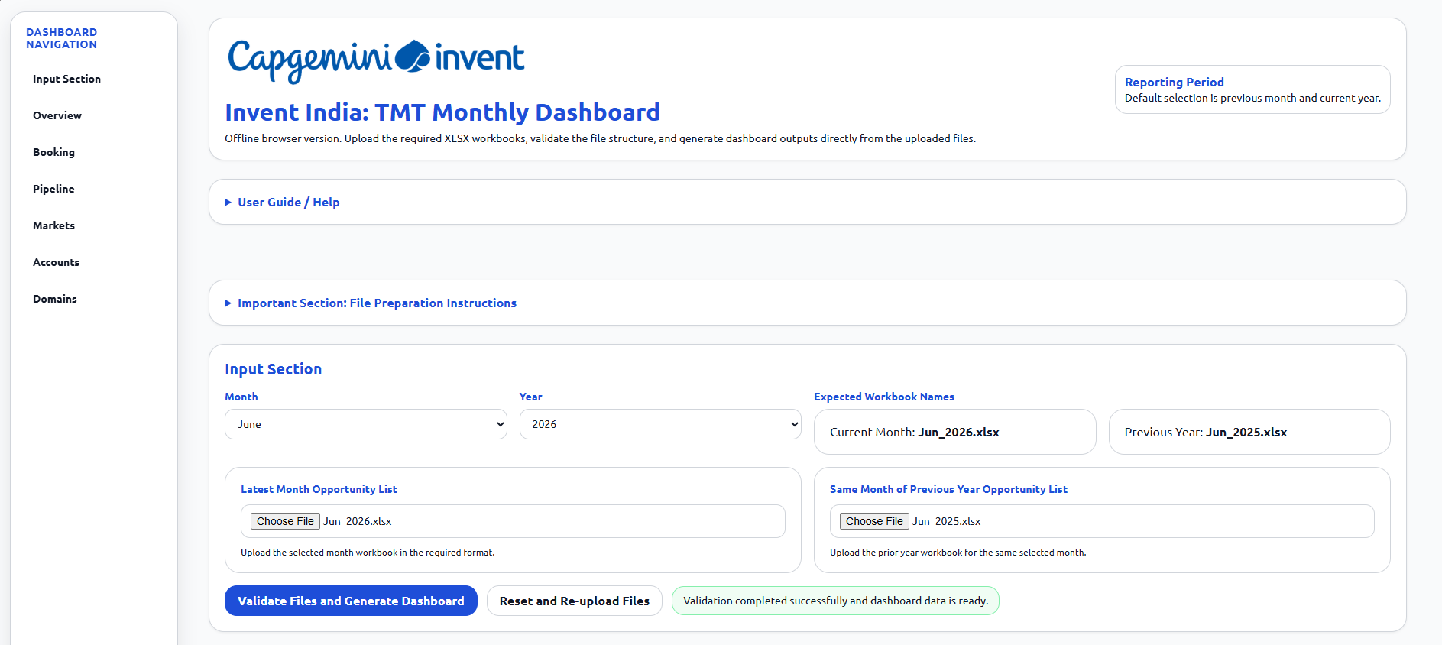
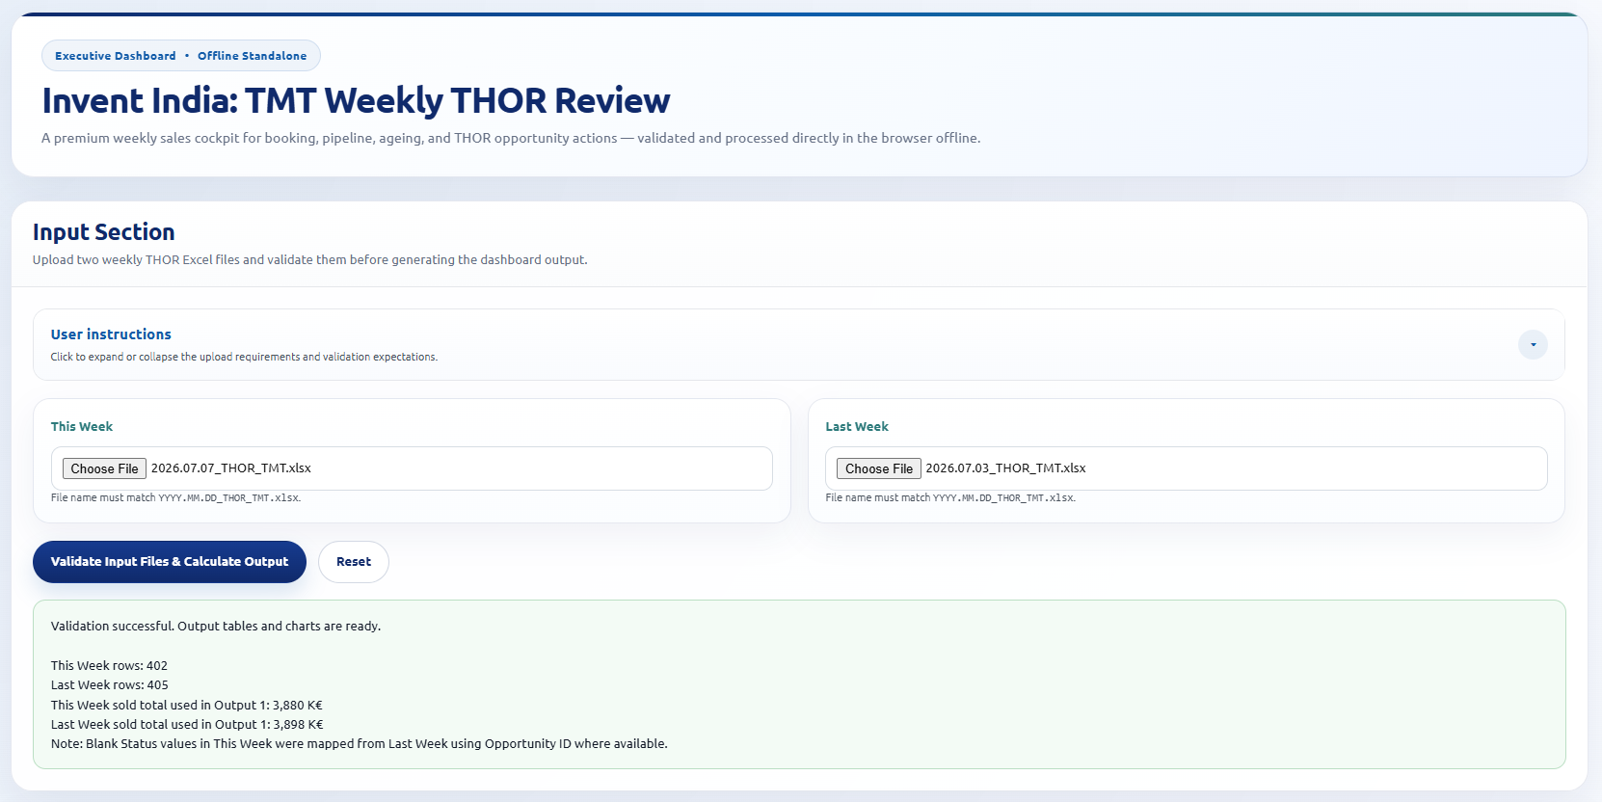
Demo : Dashboards (TMT Internal) Driven via vibe-coding
TMT Monthly Management Dashboard
Weekly THOR Opportunity Dashboard
The solution automatically ingests monthly THOR opportunity reports, validates data quality and structure, and generates a comprehensive management dashboard covering bookings, pipeline health, market performance, account insights, domain analysis, target attainment, and year-over-year trends.
Unlike traditional reporting solutions that require multiple manual data preparation and presentation activities, this dashboard performs end-to-end processing directly within the browser, providing leadership teams with a real-time, standardized view of business performance.
The solution converts the weekly THOR opportunity review process into a structured, automated, and executive-ready dashboard that supports faster sales governance, pipeline visibility, and booking decision-making.
The dashboard takes the current week and previous week THOR reports as inputs and automatically generates a standalone executive dashboard. It provides a consolidated view of booking performance, pipeline health, projected booking, stage movement, ageing pipeline, and opportunity-level actions.
TMT Monthly Update | July 2026
24

Slide 25
Make
it
real.

Slide 26
Segment Mix & Pipeline Coverage Trend | Jan–May 2026
Monthly SOLD (KE)
Pipeline-to-Sold Coverage (x)
Inter vs. Intra Segment Mix (%)
Target: 2.00x
May end coverage : TCV Pipeline (4736 KE) / TCV Sold (3460 KE)
Segment Shift: INTER eased ↓7% (60%→53%); INTRA rose to 47%, driven by volume pressure in key INTER accounts.
Pipeline Coverage: Compressed from 2.25x → 1.36x. Recovery to ≥2x is the immediate pipeline priority.
TMT Monthly Update | July 2026
Company Confidential © Capgemini 2026. All rights reserved.

Slide 27
Strategic Revenue Growth Levers – People, Billing, Utilization
Target Revenue : 2400K
ARVE : 75%
Current growth parameters As on 10th June 26
Bench : 14
Resources : 46
Inter Projects - 54%
Milestones
Growth Levers
People
Current Revenue received till May end : 927 K
Projected Revenue which can be achieved from June to December : 1200 K
Current People on Project will remain on project till end of the year with same rates.
The current resources on Bench will be allocated to project for at least 3 months
New resources joining in Aug will be allocated to project for at least 2 months
August
The total TMT Headcount should be ~58
June
Increased Inter rates for new assignments
Billing
Scenarios (existing bench on inter) | Revenue Forecast
Bench resources will be allocated to Project for 5 months & new resources will be on project for 4 months | 1300 K
Bench resources will be allocated to Project for 2 months & new resources will be on project for 1 months | 1100 K
August
CM Margin check- to be ~45% for all resources
December
Inter: Intra project ratio should be ~50:50
Utilization
Business Consulting/BA | Solution Designer & Arch/EA | Program Management | Process Consulting
-SFCC(Enterprise Sales/CPQ) external certified resources -Service Now certification -L0/L1 –Solution Architect Certification | -TM Forum Autonomous Network certified resources -SFCC(Enterprise Sales/CPQ) external certified resources -BA certification –L1/L2 | -Engagement Manager -Telco L3 Certifications | -Service now certified resources -SFCC(Enterprise Sales/CPQ) external certified resources -Telco L3 Certification
July
Bench should be minimized to 4-5 resources
Oct
Bench –not more than ~4

Slide 28
Strategic Revenue Growth Levers
Revenue Confirmed till May’26 927 KE
Target Revenue : 2400K
Resources: 46 | Bench: 13 | Inter Projects: 45% | New Hires Planned: 9 | New Joiners Confirmed: 4
80%
85%
88%
93%
99%
927 + 993
1920 KE
927 + 1122
2049 KE
927 + 1183
2110 KE
927 + 1294
2221 KE
927 + 1450
2377 KE
Resources = 46
Bench = 13
Inter = 45% (15)
Intra = 55% (18)
New Hires = 0
Resources = 50 ↑
Bench = ~9 ↓
Inter = 45% (18)
Intra = 55% (23)
New Hires = 4 ↑
Resources = 50
Bench = ~5 ↓ ↓
Inter = 45% (20)
Intra = 55% (25)
New Hires = 4
Resources = 50
Bench = ~5 ↓ ↓
Inter = 55% (25) ↑
Intra = 45% (20) ↓
New Hires = 4
Resources = 50+4 ↑ ↑
Bench = ~4 ↓ ↓
Inter = 55% (27) ↑
Intra = 45% (23) ↓
New Hires = 4+4 ↑
Utilization | AI Strategy | Business Consulting/BA | Solution Designer & Arch/EA | Program Management | Process Consulting
 | -Capgemini AI Activate Program - AI Certifications from Google, Anthropic, Microsoft, AWS, Open AI, TMForum - AI Roadmap – TMT Team | -SFCC(Enterprise Sales/CPQ) external certified resources -Service Now certification -BA certification –L1/L2 | -TM Forum Autonomous Network certified resources -SFCC(Enterprise Sales/CPQ) external certified resources -L0/L1 –Solution Architect Certification | -Engagement Manager -Telco L3 Certifications | -Service now certified resources -SFCC(Enterprise Sales/CPQ) external certified resources -Telco L3 Certification

Slide 29


May 2026 Performance Dashboard
(Top Markets & Accounts – Wt. Pipeline)
408
93
NCE = 786 KE
NA = 554 KE
116
SCE = 576 KE
81
India = 351 KE
80
344
118
69
61
ME = 228 KE
ANZ = 88 KE
213
88

Slide 30
Revenue | ARVE | Inter CM
39%
75%
54%
927 KE Revenue
(Target (1 ME)- 42%)
ARVE%
(Target 70%)
CM% Inter
(Target 46%)
REVENUE
as of May
ARVE%
CM% (INTER)
as of May
ARVE: Activity Rate (Vacation Excluded)
CM: Contribution Margin

Slide 31






RFPs & Proactive Pitches
Anurag/Riya/Shripriya
Tuatahi
Telia
Orange
Maxis
Dell
Leading OSS and product‑rationalization transformation using ServiceNow, ArcGIS, Salesforce, MACD automation and PLM with Invent, DCX and Sogeti
Proactive Agentic workflow for L2OAccelerating Agentic AI‑powered finance modernization across FP&A, forecasting, fraud management, and planning with tailored AI use‑case development
POV was intended to showcase the benefit of IT Mutualization which covered the best practices for implementation, recommended IT mutualization Architecture and learnings from failures
Wholesale will become a platform-led digital infrastructure player through a data-driven strategy, operating model transformation, and a five-year roadmap for scalable growth
Dell will enhance online care to boost self-service, reduce support tickets, and improve customer experience, with Invent leading solution architecture and product management
NBN RFP targets accelerating enterprise digital and AI transformation, focusing on execution, value-driven roadmaps, process transformation, and scalable AI
Saudi Telecom
Liberty LAM
Fastweb + Vodafone
ASML
NBN
Re‑engineering 464+ wholesale processes using ARIS‑driven process design, supported collaboratively by Invent India and Invent Germany
The AI Governance RFP defines Define AI governance and establish a Use Case Factory to standardize, scale, and accelerate compliant AI value delivery
Fastweb and Vodafone will consolidate vendors and automate operations to cut overlap, reduce costs, improve efficiency, and scale through centralization and harmonization
RFI seeks suppliers able to provide platform-neutral, validated benchmark data for annual workplace benchmarking and ambition-setting across key people drivers
TMT Monthly Update | July 2026

Slide 32
Ongoing Assignments
Anurag/Riya/Shripriya
Business Analyst
SD and PgM
Solution Arch.
Business Analyst
Epic Owner
We are working with the IndiGo AI Innovation Lab to build and scale AI-driven products for the airline
Responsible for creating Nuuday’s own independent Provisioning and Assurance stack, to move away from TDC IT stack
Bridges the gap between business, architecture, and development to ensure smooth, efficient, and accurate delivery of technical solutions
Responsible for business analysis and solution design within a large‑scale B2B transformation program
Leading strategic capability definition and delivery through integrated business analysis and solution design
BA/SD & TPM
Process Designer
Business Analyst
PMO
BA/PO
Comcast’s XTO Experience Transformation program, supporting a multi‑year initiative to overhaul customer service and overall customer experience
(Telefonica Spain)
Leading end‑to‑end capability design and delivery to enable a more integrated, scalable and efficient operating model
(Telefonica Germany)
Focused on translating business requirements into clear, actionable inputs for developers, supporting data-driven solutions using Data Lake technologies in the OSS domain
Program Management for CMA CGM’s R&D Hub with focus on building AI-driven industrial digital twins
Service Manager Migration, implementing WOA for Feasibility Check and New Service Provisioning (incl. MACD) in Colombia and scaling WOA and integrations across LATAM
TMT Monthly Update | July 2026

Slide 33
Ongoing Assignments
Anurag/Riya/Shripriya
Business Analyst
Lead BA
To support a billing-transformation initiative through Requirements Framework, reference data model and Target Operating model, including technology gap assessment for Kenan and Oracle BRM
For complex billing transformations by translating end-to-end billing processes into clear requirements, process flows, and delivery-ready solutions across business and technology teams.
TMT Monthly Update | July 2026

Slide 34
Chandamita/Nilesh/Shikha
Revenue Confirmed till Jun’26 1109 KE
Strategic Revenue Growth Levers
Target Revenue : 2400K
CURRENT: Resources: 47 | Bench: 10 | Inter Projects: 49% | New Joiners Confirmed: 3 I New Hires Planned: 4
Milestones
Possible Case
Best Case
Worst Case
Resources = 50
Current Bench = 10
(8 Moved to Intra, 2 on Bench)
Inter = 38% (18)
Intra = 62% (30)
Resources = 50
Bench = 2
(8 Moved to Inter, 2 on Bench)
Inter = 60% (29)
Intra = 40% (19)
Resources = 50
Bench = 5
Inter = 40% (18)
Intra = 60% (27)
July
Inter % increased by 4% since Jun
Inter: Intra project ratio is ~49:51
Scenarios (With 47+3 Resource) | Revenue Forecast
Possible Case All Bench & New resource, on Intra | 2006 K, with gap of 394 K
Best Case All Bench & New resource, on Inter | 2411 K, exceeding target
Worst Case New resources and 2 existing on bench, remaining bench on Intra | 1841 K, with gap of 559 K
Aug
The total TMT Headcount will be ~50
Sep
Bench should be minimized to 2-5 resources
Key Takeaways
Reduce Bench resources from 10 to 4/5
Prioritize INTER roles compared to INTRA
Take up Cross domain roles where applicable
Maintain 100% utilization
Callout to Account owners with INTER accounts, to explore new roles with their counterparts
Continue new hiring (of additional 4 resource) for FY’26, only if there is upcoming confirmed opportunity. Else revenue gap will increase further for FY’26.
Nov
Total TMT Resource count, if additional 4 New Resources Hired ~ 54

